Slide 1

Hotel booking for a Resort Hotel & a City Hotel
June 20th 2024

Slide 2

Introduction
There are 4 analysts deciphering data
Lavanya Bhanot
Deogratius Nteza
Xuan (Sam) Chen
Judy Pin
Lavanya
Notes:
Lavangia –introduction
Deo explain the data

Slide 3

Data Explanation
Deo
Notes:
Deo

Slide 4
Dataset
hotel: Type of hotel (Categorical)
is_canceled: Whether the booking was canceled or not (Binary)
lead_time: Number of days between booking date and arrival date (Numeric)
arrival_date_year: The year of the arrival date (Numeric)
arrival_date_month: The month of the arrival date (Categorical)
arrival_date_week_number: The week number of the arrival date (Numeric)
arrival_date_day_of_month: The day of the month of the arrival date (Numeric)
stays_in_weekend_nights: Number of weekend nights stayed or booked to stay at the hotel (Numeric)
stays_in_week_nights: Number of week nights stayed or booked to stay at the hotel (Numeric)
adults, children, babies: Number of guests categorized by age groups
adults = Number of adults
children = Number of children
babies = Number infants
Booking Details:
meal: Type(s) food option(s) included in booking package (Categorical)
country & market_segment & distribution_channel columns provide demographic and customer classification information.
is_repeated_guest column specifies whether a guest is a repeated visitor or not.
previous_cancellations column indicates how many previous bookings were canceled by a guest.
previous_bookings_not_canceled shows how many previous bookings were not canceled by a guest.
Accommodation Details:
reserved_room_type column indicates which type room was originally reserved for each booking. assigned_room_type mentions which type room was finally assigned for each booking.
booking_changes: Number of changes made to the booking before arrival.
deposit_type: Type of deposit made for the booking (Categorical).
agent & company columns provide relevant information about the travel agency and/or company involved in making the reservation.
Additional Information:
days_in_waiting_list: Number of days the booking was on a waiting list before it was confirmed or canceled.
customer_type provides information on types of customers (Categorical)
adr: Average daily rate per room, calculated by dividing the sum of all lodging transactions by the total number of staying nights (Numeric

Slide 5
Dataset …
Data Source: https://data.world/mesum
Modifications
Original Row Count: 119391
Filtered: 59342
Fields Added
Country Name
Latitude (Average)
Longitude (Average)
Room_nights
Amount_spent

Slide 6

Spend Judy

Slide 7
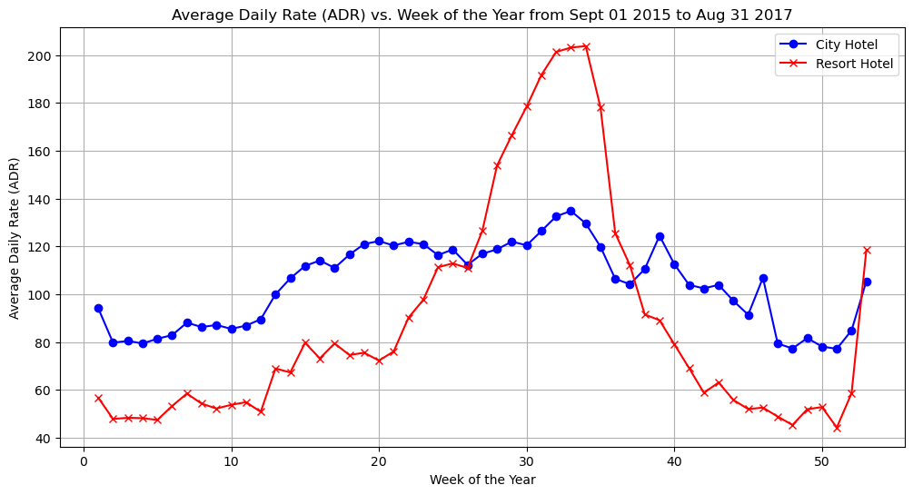

Slide 8
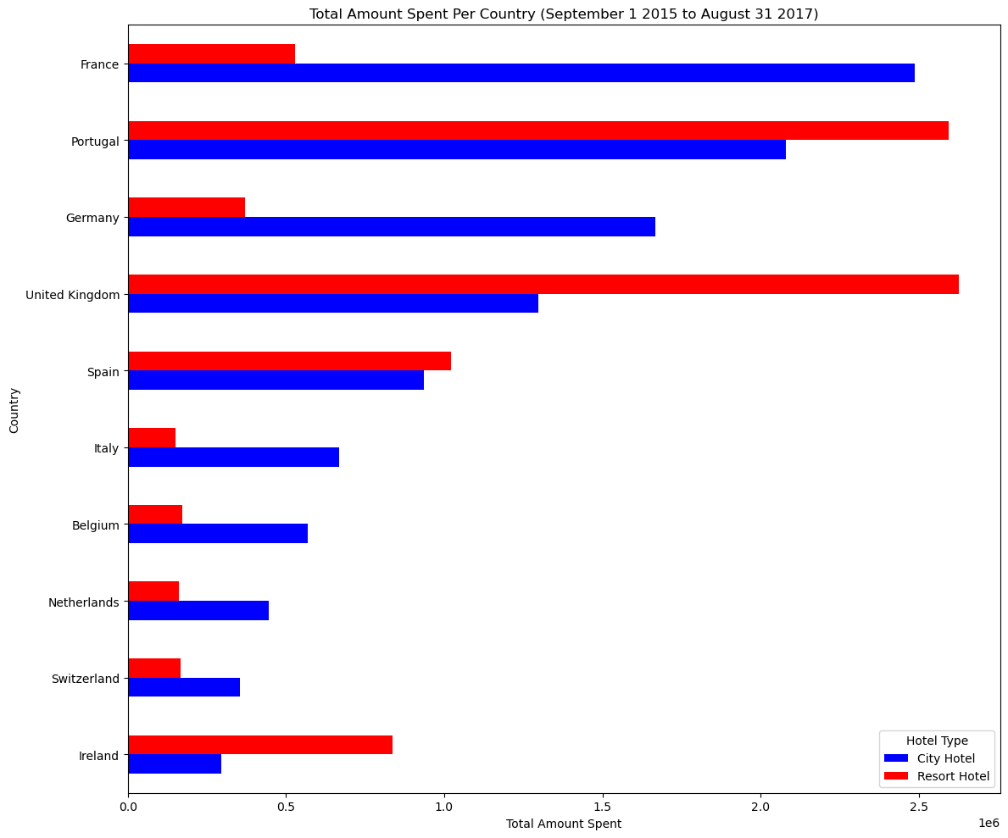

Slide 9
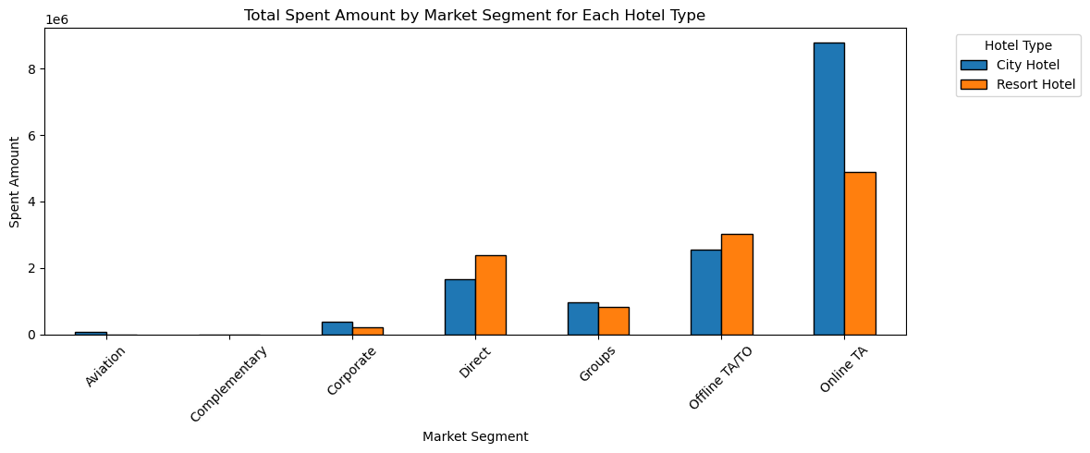

Slide 10
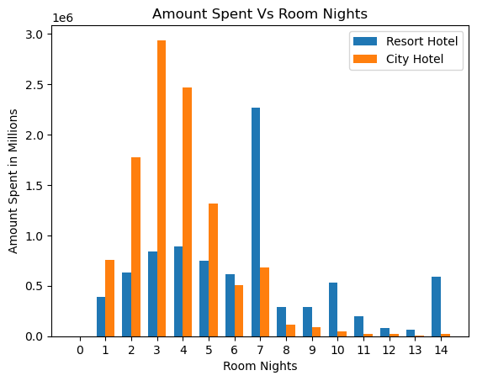

Slide 11

TBD Title Lavanya

Slide 12

Bookings Deo

Slide 13
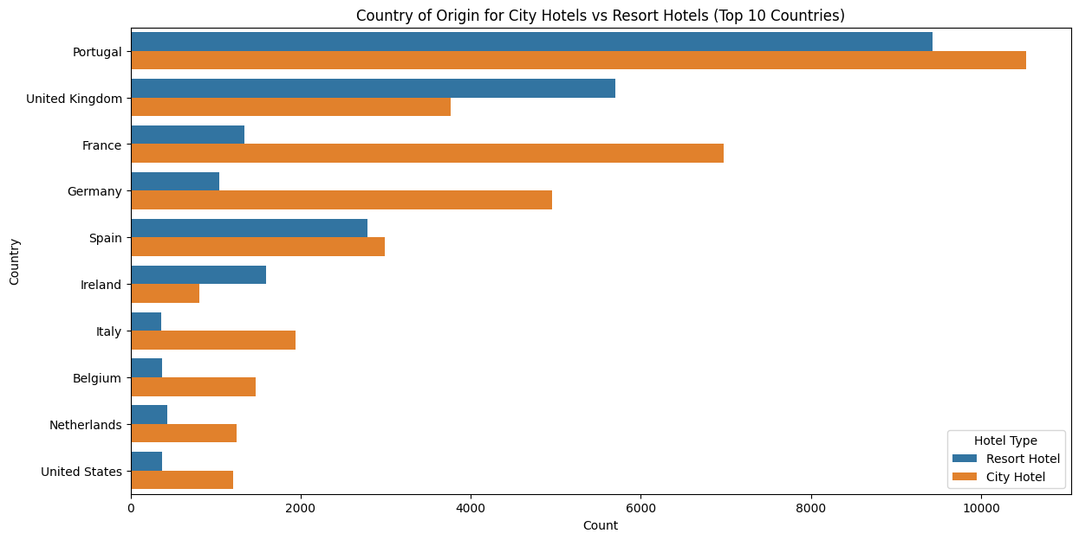
Distribution of bookings by guest country
City Hotels are particularly popular among guests from France, Germany, Italy, Belgium, and the Netherlands.
Resort Hotels are preferred by guests from the UK, Ireland, and Portugal.
Guests from Spain and the USA are relatively balanced in their preferences, though city hotels have a slight edge in both cases.

Slide 14
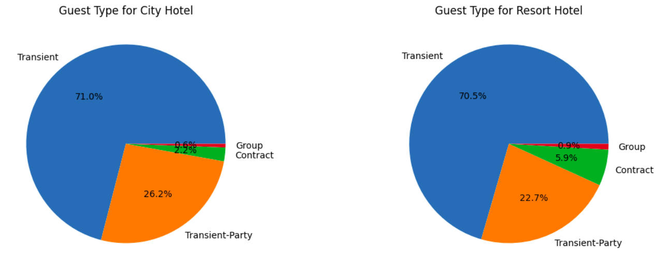
Guest Segments by hotel type
Transient customers are the dominant segment for both city and resort hotels, making up about 7071% of the total.
TransientParty customers are the second largest segment for both hotel types, though they constitute a slightly higher percentage in city hotels (26.2%) compared to resort hotels (22.7%).
Group bookings are minimal for both hotel types, slightly higher in resort hotels (0.9% vs. 0.6%).
Contract customers make up a larger proportion in resort hotels (5.9%) compared to city hotels (2.2%).

Slide 15
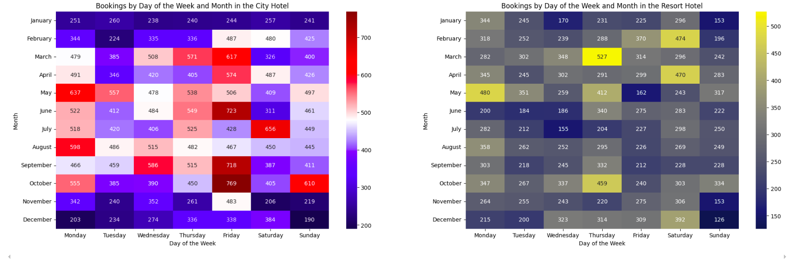
Bookings by Day of Week
City Hotel Peak: High booking numbers in May and October, particularly on Mondays.
City Hotel Low: Fewest bookings on Saturdays across various months.
Resort Hotel Peak: Highest bookings in August, especially on Sundays.
Resort Hotel Low: Lower bookings in November and December.

Slide 16
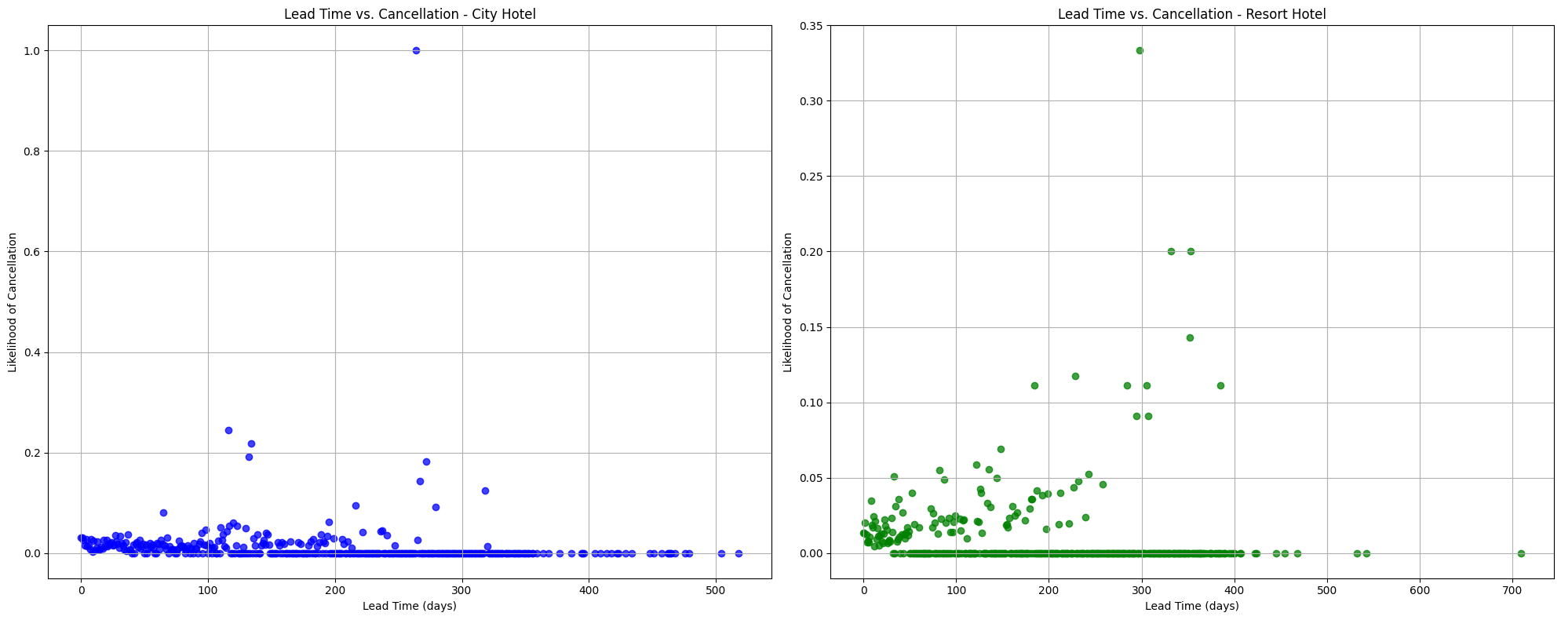
Lead time vs. Cancellation
Short Lead Times: For both hotels, bookings with shorter lead times (0100 days) are the most common. The likelihood of cancellation is generally low in this range, suggesting that lastminute bookings are more likely to be honored.
Long Lead Times: Both plots show that bookings with longer lead times have higher cancellation rates. This could be due to changes in plans over time, making it more likely for guests to cancel.
Hotel Type Differences: The Resort Hotel shows a more consistent trend of increasing cancellation likelihood with lead time, while the City Hotel has a noticeable peak at the longest lead time.

Slide 17

Agents Sammy

Slide 18
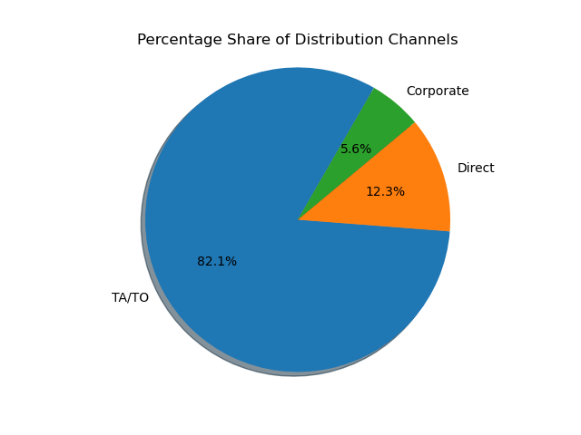

Slide 19
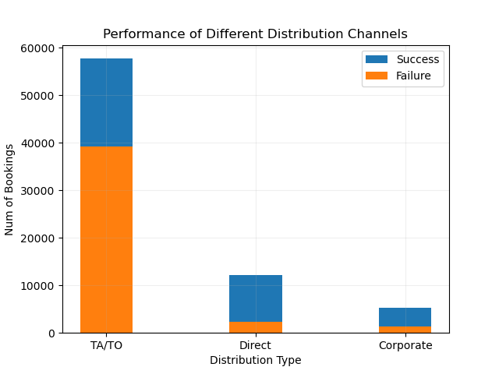

Slide 20
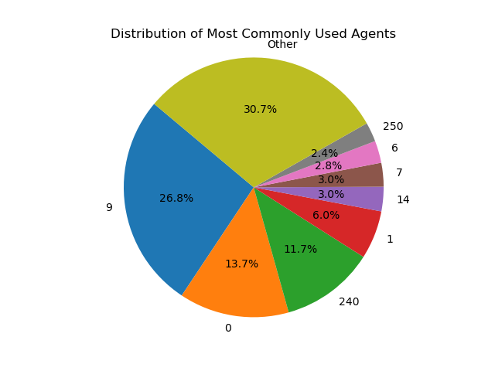

Slide 21
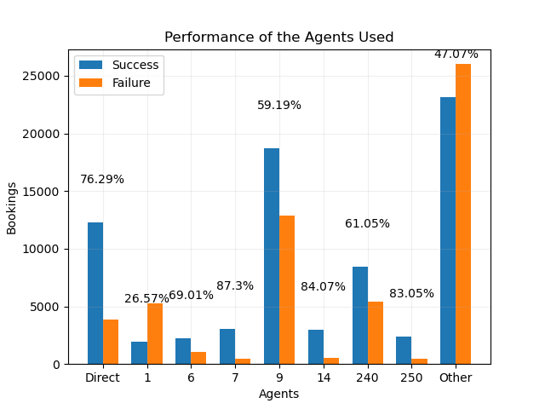

Slide 22
Room Types, Revenue and Cancellations Lavanya

Slide 23
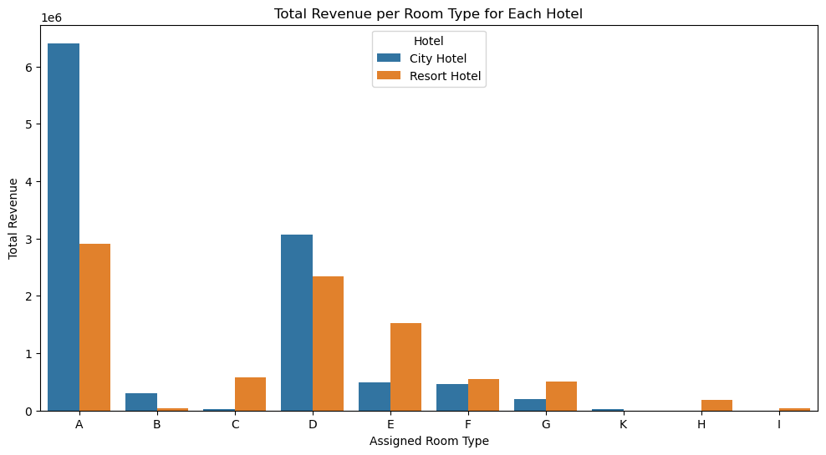

Slide 24
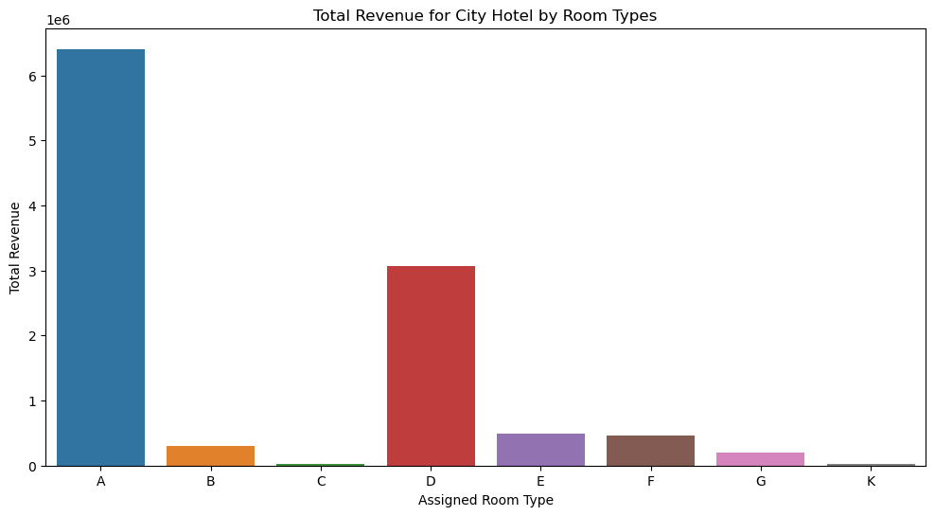

Slide 25
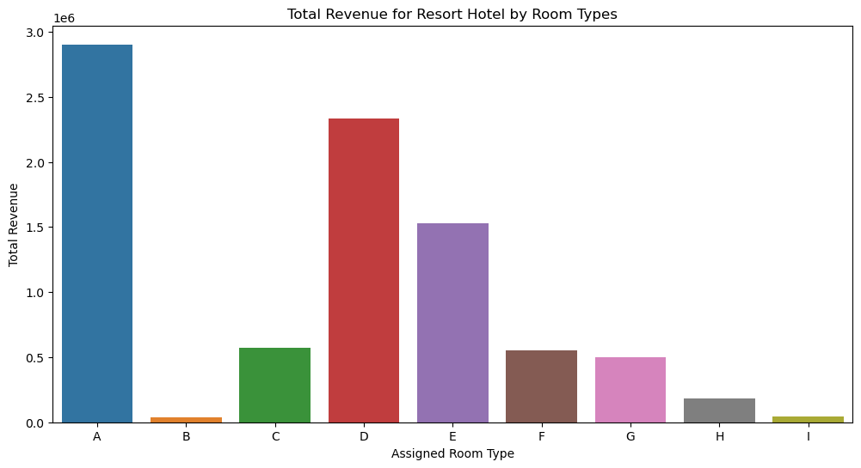

Slide 26
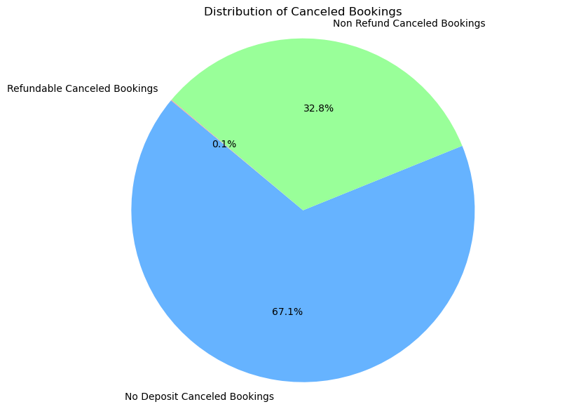
Total Canceled Bookings: 44224
Refundable Canceled Bookings: 0.08%
No Deposit Canceled Bookings: 67.14%
Non Refund Canceled Bookings: 32.77%

Slide 27
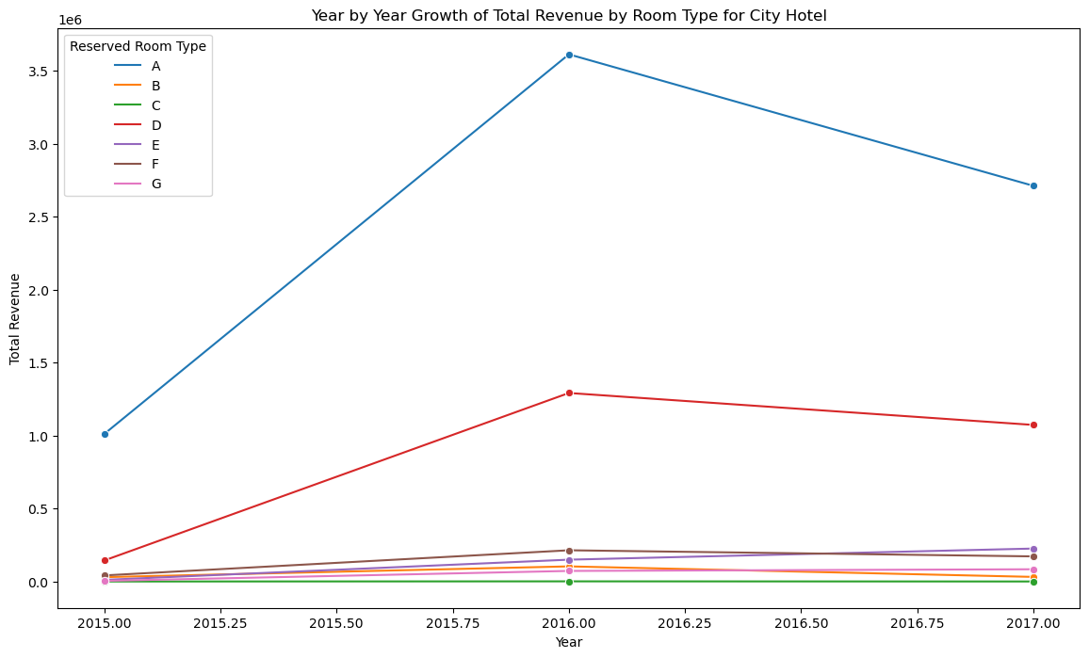

Slide 28
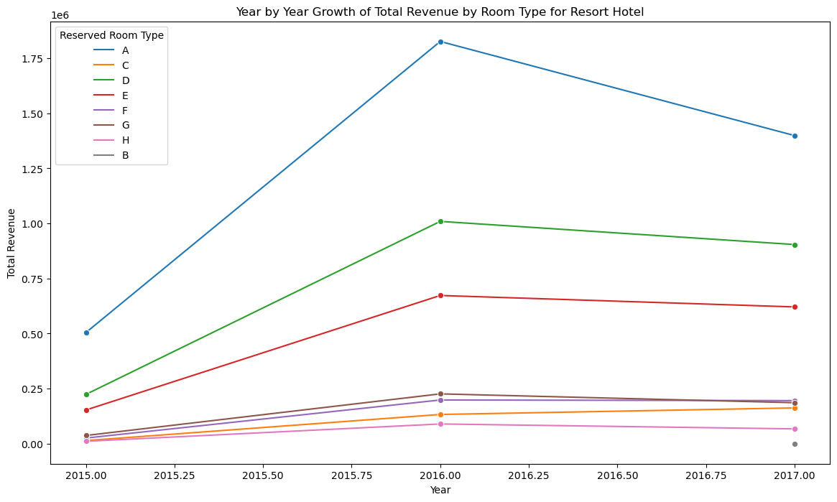

Slide 29
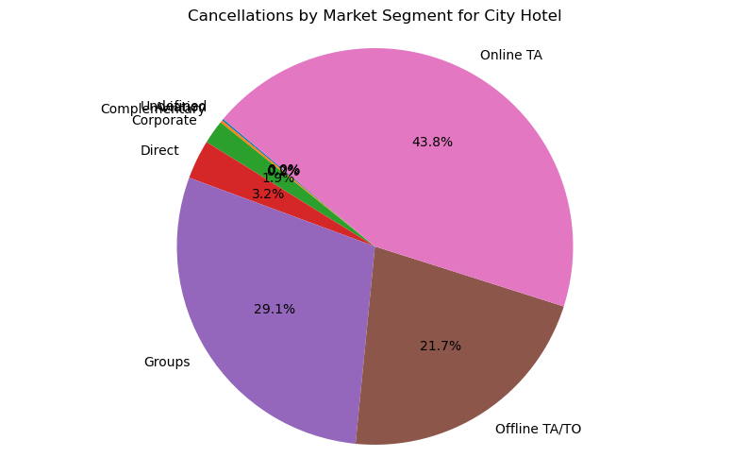

Slide 30
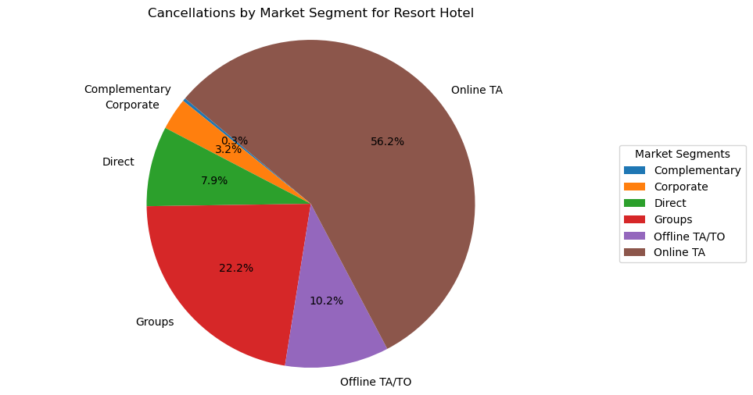

Slide 31
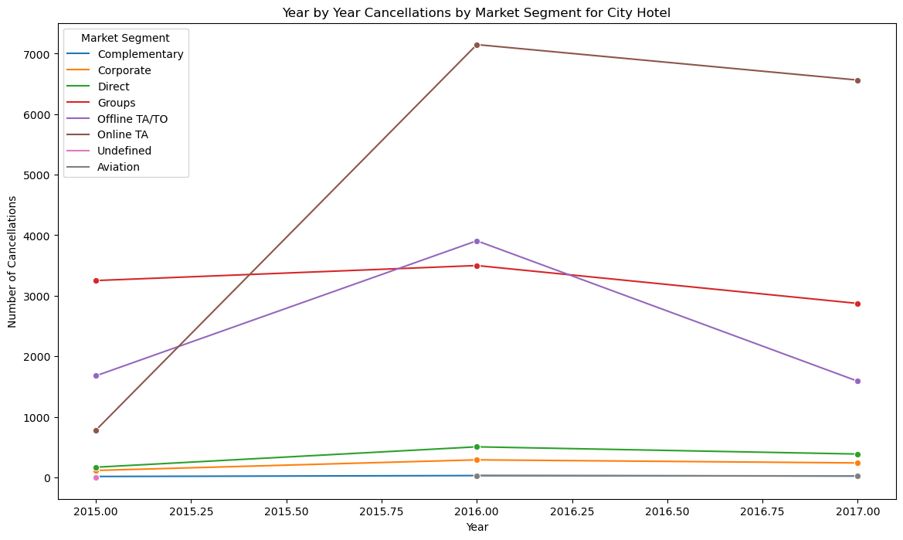

Slide 32
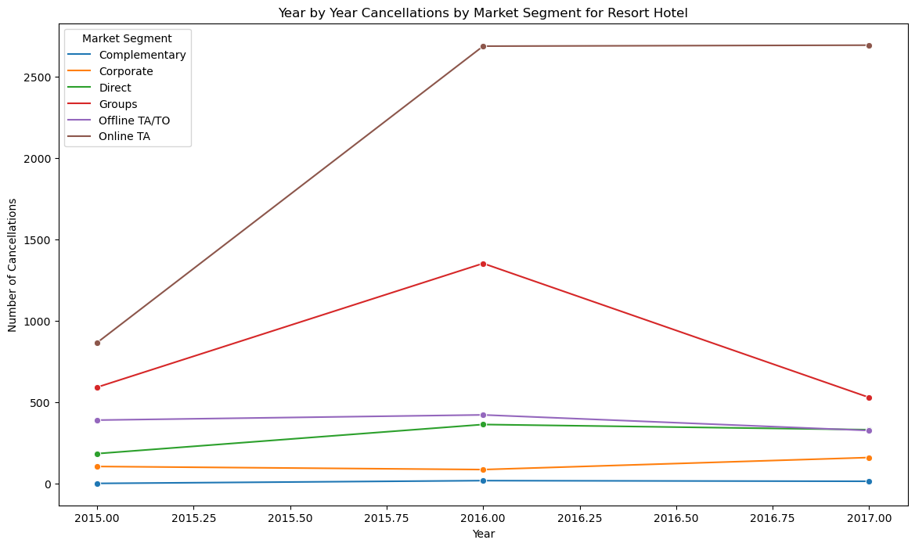

Slide 33
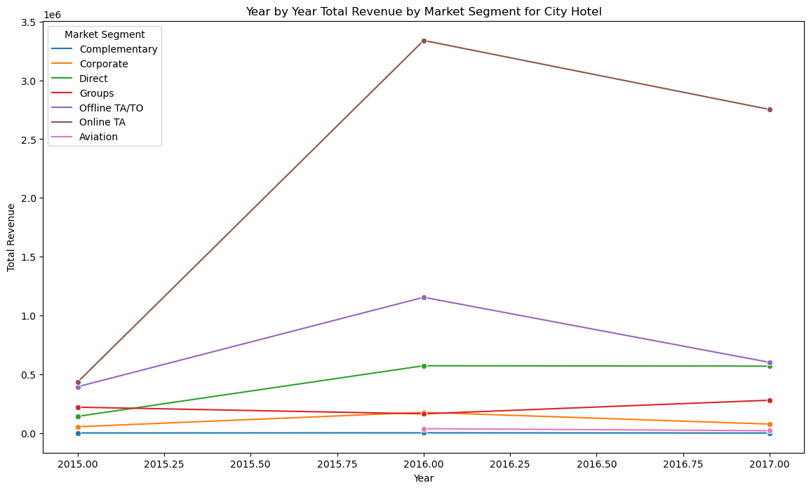

Slide 34
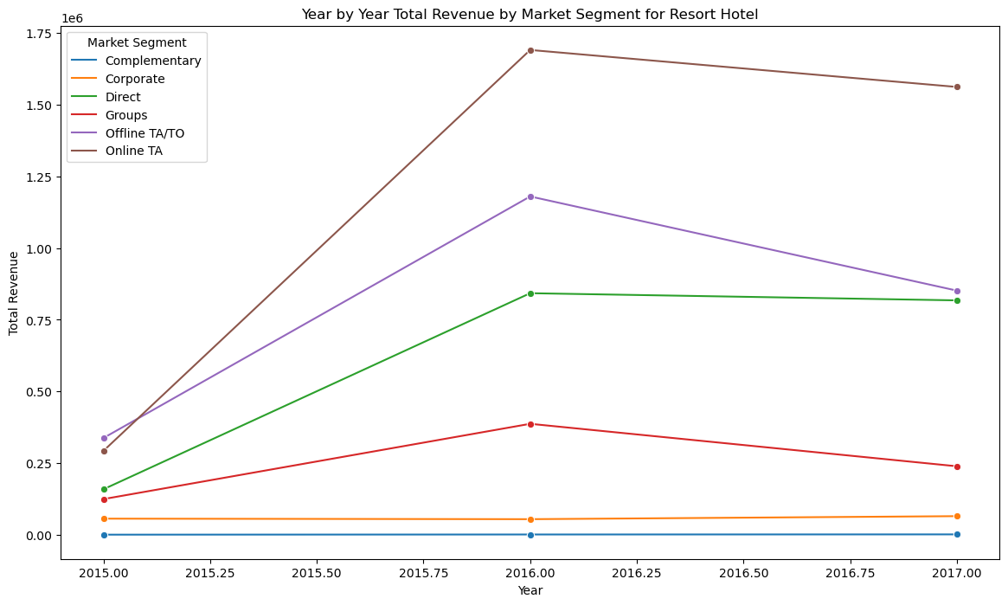

Slide 35

Conclusion
Judy
Notes:
Judy conclusion

